Slide 1

INFO- 6001
Information Security
Gihan Shamike Liyanage
1142109
LAB SUBMISSION 4

Slide 2
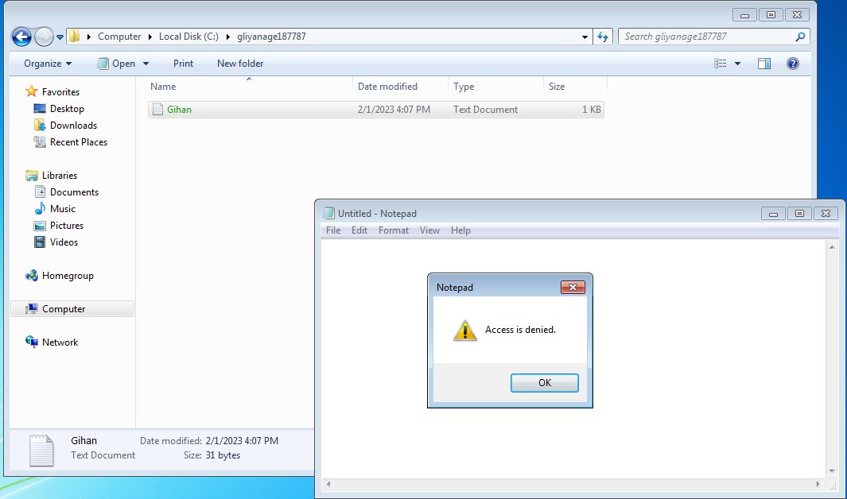
Screen Shot 1
2

Slide 3
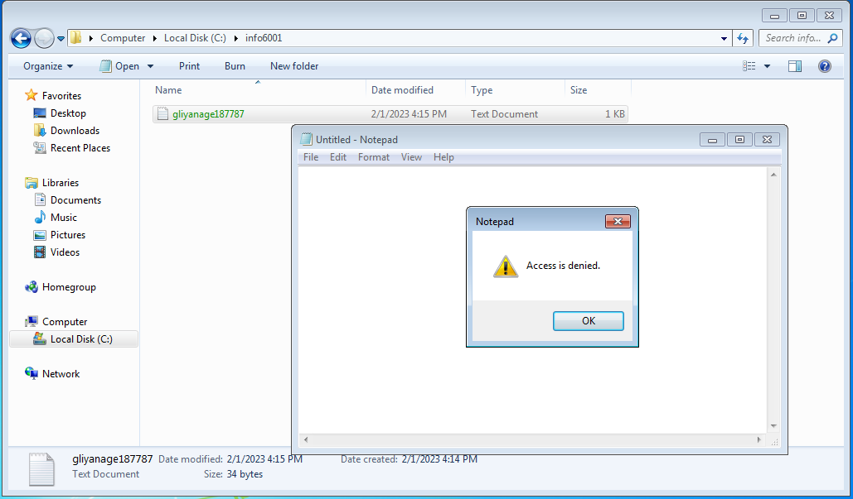
Screen Shot 2
3

Slide 4
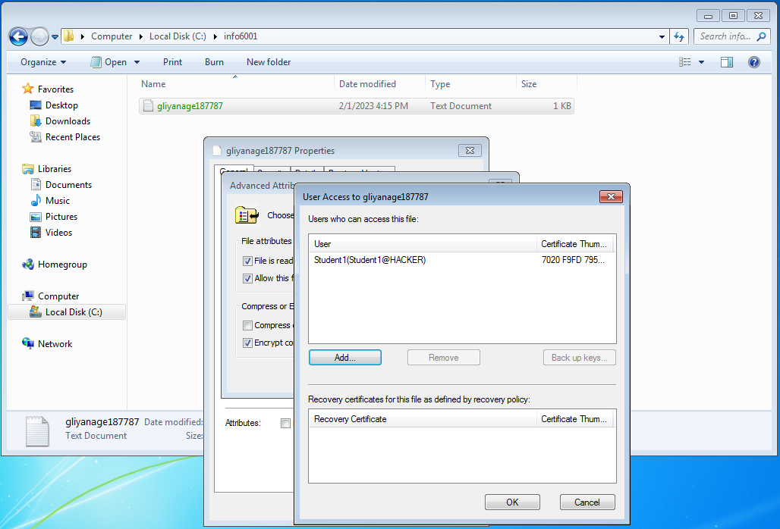
Screen Shot 3
4

Slide 5
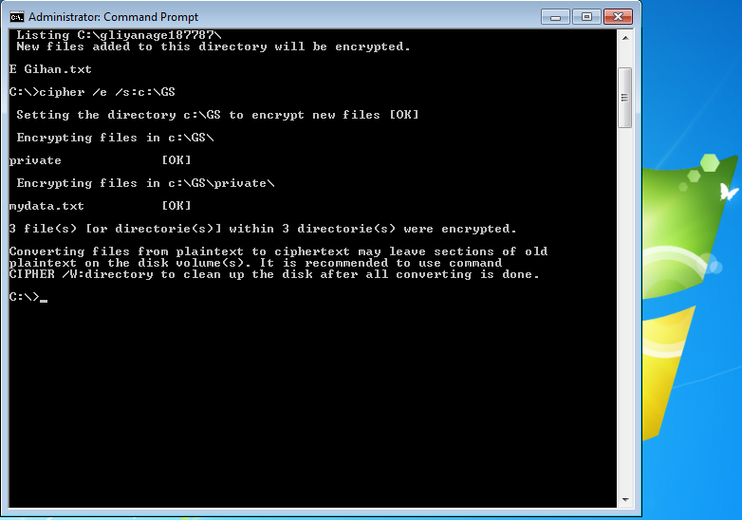
Screen Shot 4
5

Slide 6
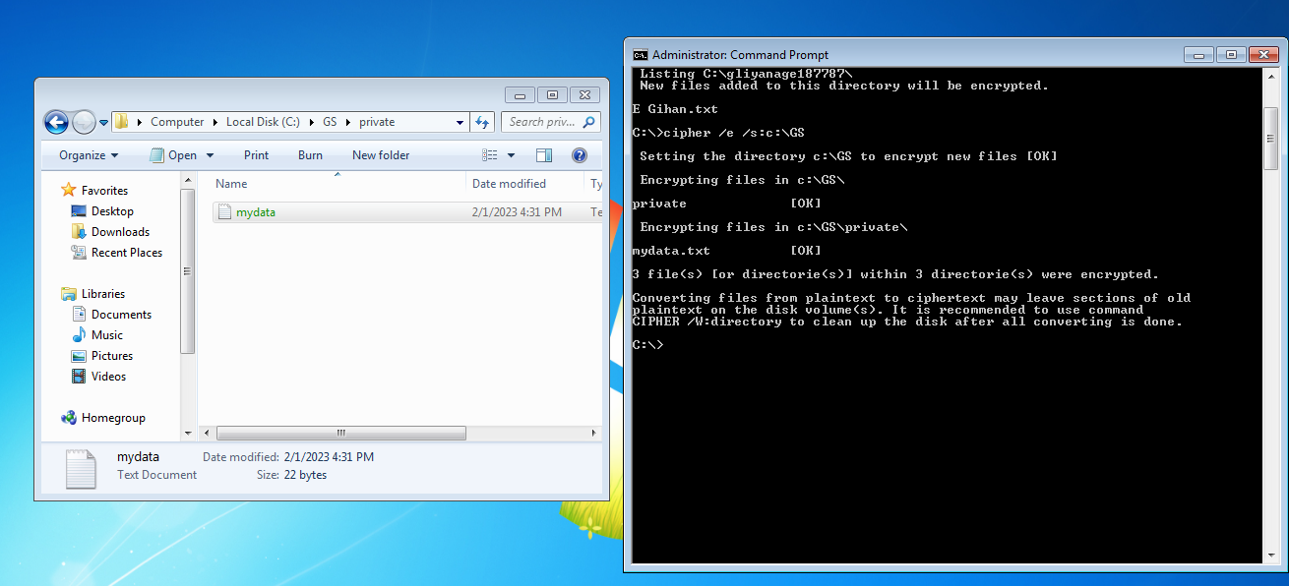
Screen Shot 5
6

Slide 7
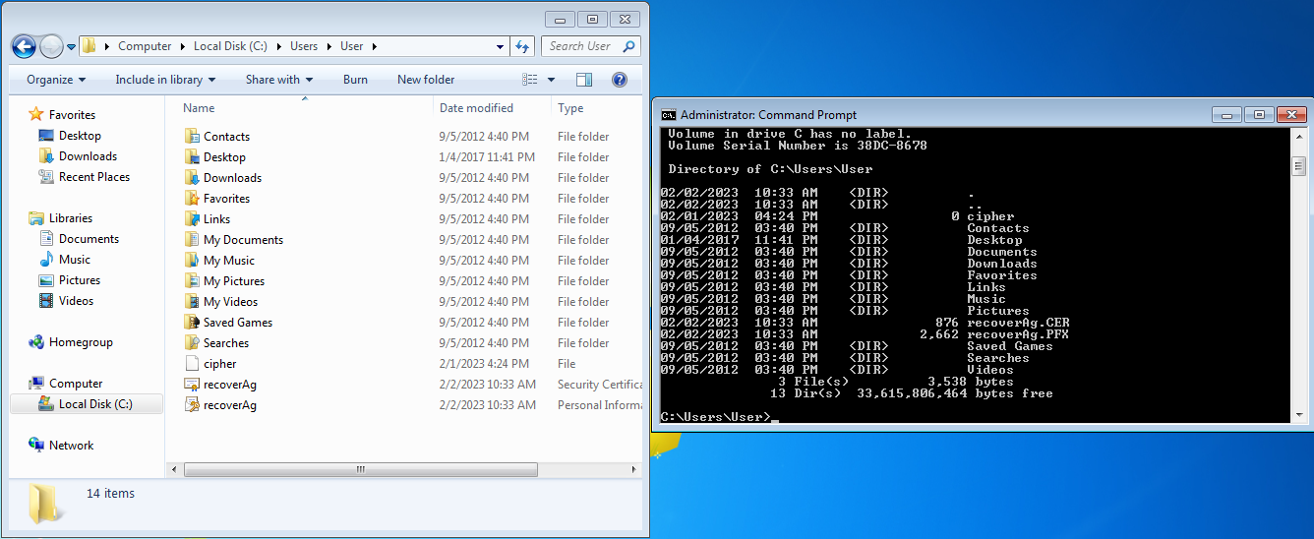
Screen Shot 6
7

Slide 8
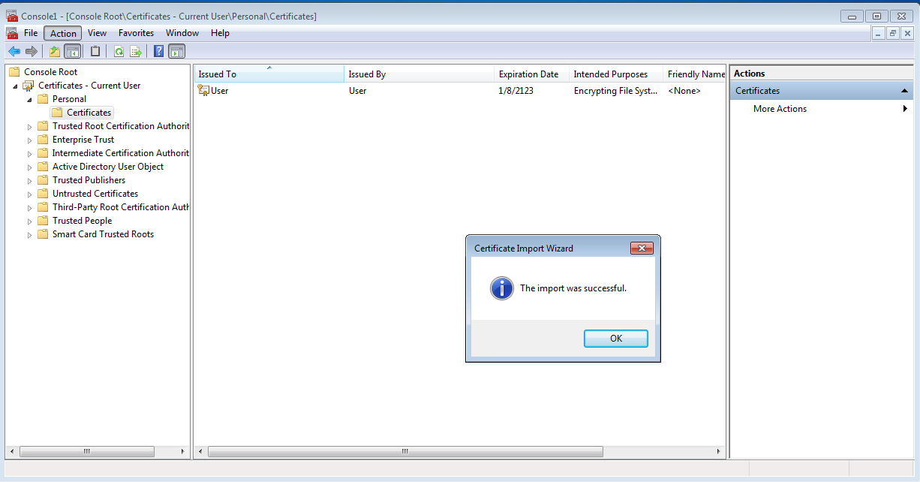
Screen Shot 7
8

Slide 9
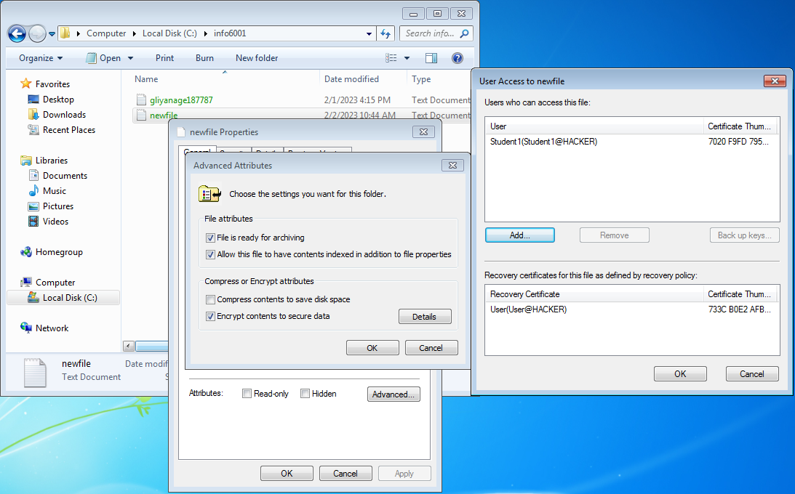
Screen Shot 8
9

Slide 10
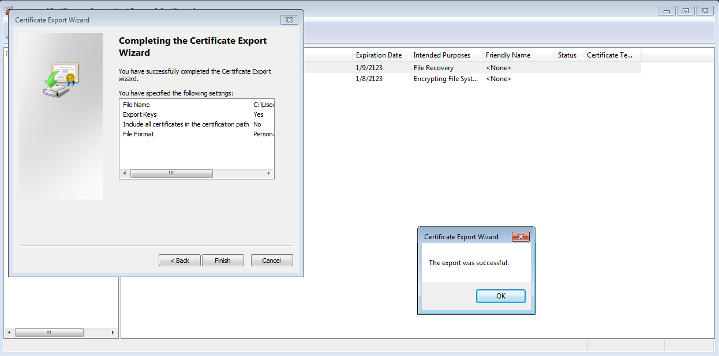
Screen Shot 9
10

Slide 11
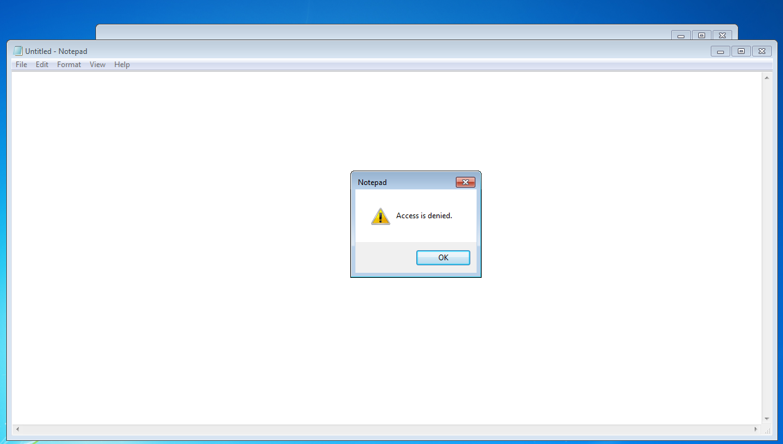
Answers to Question 10
Because recovery agent certificate is deleted and the Recovery Agent cannot access the files.
File access will be denied until the recovery agent certificate is restored.

